Slide 1


Chapter 10: DHCP
Routing and Switching Essentials
Notes:
Cisco Networking Academy program
Routing and Switching Essentials
Chapter 10: DHCP

Slide 2
Introduction Introduction
Dynamic Host Configuration Protocol (DHCP) is a network protocol that provides automatic IP addressing and other information to clients :
IP address
Subnet mask (IPv4) or prefix length (IPv6)
Default gateway address
DNS server address
Available for both IPv4and IPv6
This chapter explores the functionality, configuration, and troubleshooting of both DHCPv4 and DHCPv6
Notes:
10.0 Introduction
10.0.1.1 Introduction

Slide 3
How it Works
DHCP works in a client/server mode.
When the client connects, the server assigns or leases an IP address to the device.
The device connects to the network with that leased IP address until the lease period expires.
The host must contact the DHCP server periodically to extend the lease.
The leasing of addresses assures that addresses that are no longer used are returned to the address pool for use by other devices.
The Bootstrap Protocol is DHCP predecessor.

Slide 4
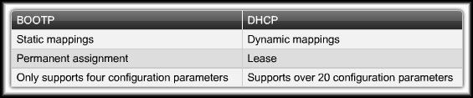
Note on BootP
Bootstrap Protocol (BOOTP):
Predecessor of DHCP.
A method to download address and boot configurations for diskless workstations.
Both DHCP and BOOTP are client/server based and use UDP ports 67 and 68.
The main difference is that BOOTP was designed for manual pre-configuration of the host information in a server database.

Slide 5
DHCPv4 Operation Introducing DHCPv4
DHCPv4 uses three different address allocation methods
Manual Allocation - The administrator assigns a pre-allocated IPv4 address to the client, and DHCPv4 communicates only that IPv4 address to the device.
Automatic Allocation - DHCPv4 automatically assigns a static IPv4 address permanently to a device, selecting it from a pool of available addresses. No lease.
Dynamic Allocation - DHCPv4 dynamically assigns, or leases, an IPv4 address from a pool of addresses for a limited period of time chosen by the server, or until the client no longer needs the address. Most commonly used.
Notes:
10.1 DHCP v4
10.1.1 DHCPv4 Operation
10.1.1.1Introducing DHCPv4

Slide 6
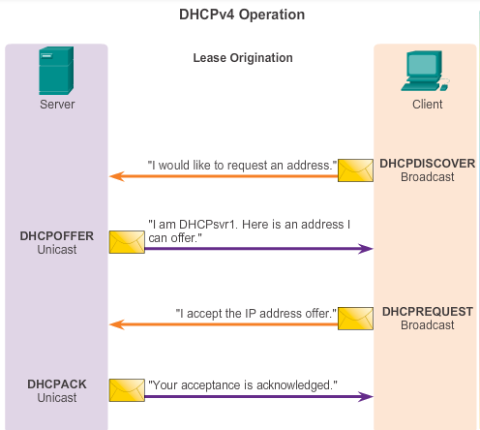
DHCPv4 Operation Introducing DHCPv4
DORA
Notes:
10.1 DHCP v4
10.1.1 DHCPv4 Operation
10.1.1.2 DHCPv4 Operation

Slide 7
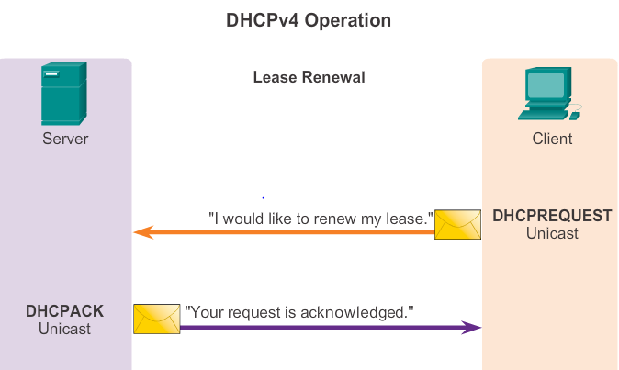
DHCP Lease Renewal
DHCP Request (DHCPREQUEST)
When the lease has expired, the client sends a DHCPREQUEST message directly to the DHCPv4 server that originally offered the IPv4 address..
DHCP Acknowledgment (DHCPACK)
On receiving the DHCPREQUEST message, the server verifies the lease information by returning a DHCPACK.

Slide 8
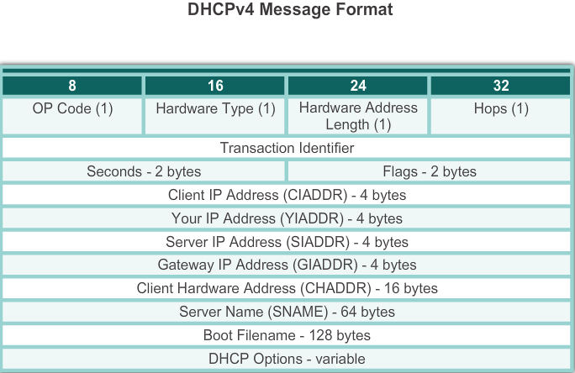
DHCPv4 Operation DHCPv4 Message Format
Notes:
10.1 DHCP v4
10.1.1 DHCPv4 Operation
10.1.1.3Introducing DHCPv4

Slide 9
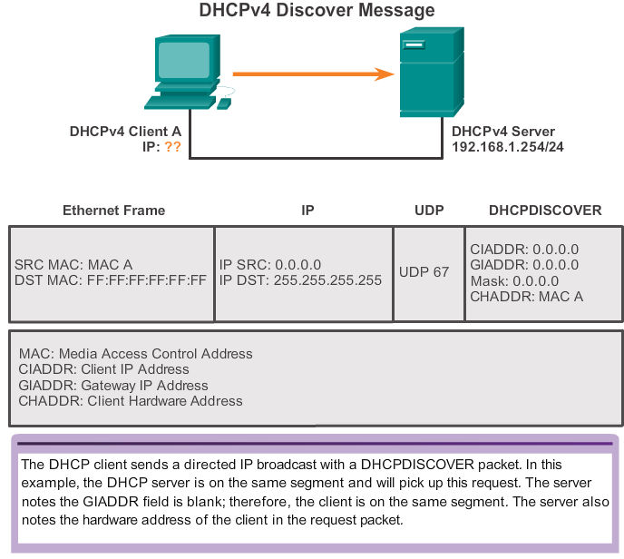
DHCPv4 Operation DHCPv4 Discover Messages
Notes:
10.1 DHCP v4
10.1.1 DHCPv4 Operation
10.1.1.4 DHCPv4 Discover and Offer Messages

Slide 10
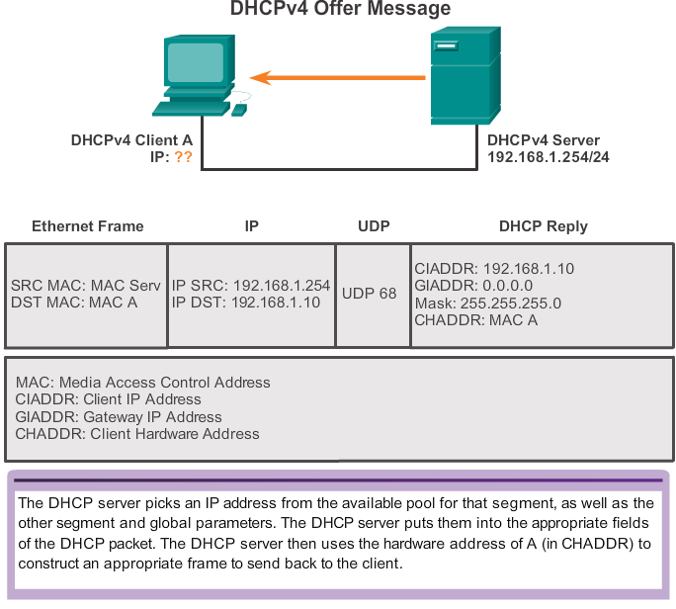
DHCPv4 Operation DHCPv4 Offer Messages

Slide 11
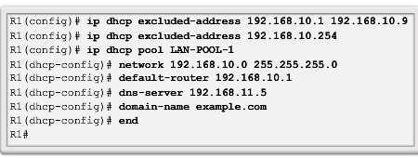
DHCPv4 Operation Configuring a DHCPv4 Server
A Cisco router running Cisco IOS software can be configured to act as a DHCPv4 server. To set up DHCP
1.Exclude addresses from the pool.
2. Set up DHCP pool name
3. Configuring Specific Tasks –define range of addresses and subnet mask. Use default-router command for default gateway. Optional items that can be included in pool – dns server, domain-name
To disable dhcp - no service dhcp
Notes:
10.1 DHCP v4
10.1.1 DHCPv4 Operation
10.1.2.1 Configuring a DHCPv4 Server

Slide 12
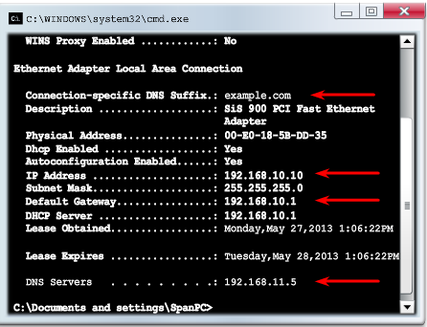
DHCPv4 Operation Verifying a DHCPv4 Server
Commands to verify DHCP
show running-config | section dhcp
show ip dhcp binding
show ip dhcp server statistics
On the PC –issue the ipconfig /all command
Notes:
10.1 DHCP v4
10.1.2Configure DHCPv4 Server
10.1.2.2 Verifying a DHCPv4 Server

Slide 13
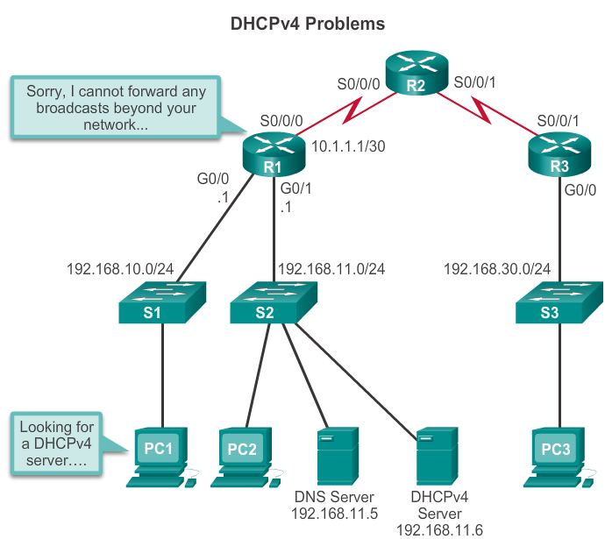
DHCPv4 Operation DHCPv4 Relay
In a large networks, enterprise servers are usually located in a server farm. These servers may provide DHCP, DNS, TFTP, and FTP services for the network.
Network clients are not typically on the same subnet as those servers. In order to locate the servers and receive services, clients often use broadcast messages.
As a solution to this problem, an administrator can add DHCPv4 servers on all the subnets. However, creates additional cost and administrative overhead.
A better solution is to configure a Cisco IOS helper address. This solution enables a router to forward DHCPv4 broadcasts to the DHCPv4 server

Slide 14
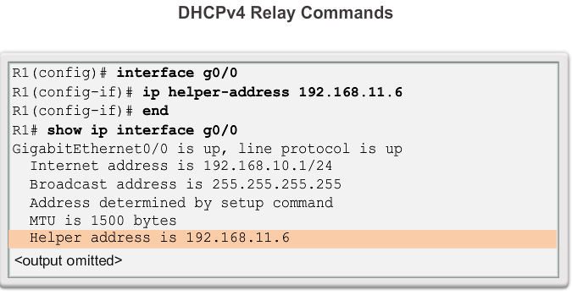
DHCPv4 Operation DHCPv4 Relay
Using an IP helper address enables a router to forward DHCPv4 broadcasts to the DHCPv4 server. Acting as a relay.
Address of the DHCP Server
Notes:
10.1 DHCP v4
10.1.2Configure DHCPv4 Server
10.1.2.3 DHCPv4 Relay

Slide 15
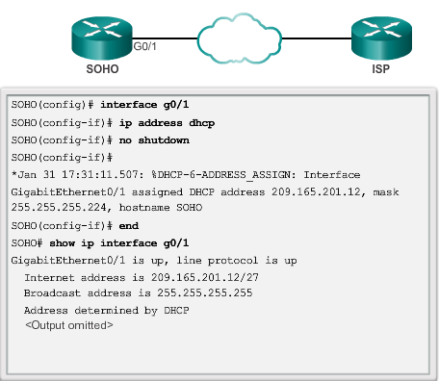
Configuring a DHCPv4 client Configuring a Router as DHCPv4 client
Sometimes, Cisco routers in small office/home office (SOHO) and branch sites have to be configured as DHCPv4 clients in a similar manner to client computers.
Notes:
10.1 DHCP v4
10.1.3 Configuring a DHCPv4 client
10.1.3.1 Configuring a Router as DHCPv4 Client

Slide 16
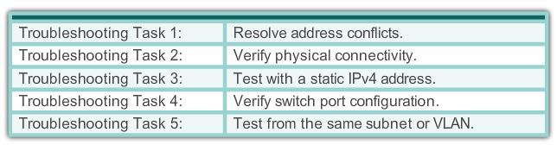
Troubleshoot DHCPv4 Troubleshooting Tasks
DHCPv4 problems can arise for a multitude of reasons, such as software defects in operating systems, NIC drivers, or DHCP relay agents, but the most common are configuration issues.
Because of the number of potentially problematic areas, a systematic approach to troubleshooting is required, as shown below.
Notes:
10.1 Managing IOS System Files
10.1.4 Troubleshoot DHCPv4
10.1.4.1 Troubleshooting Tasks

Slide 17
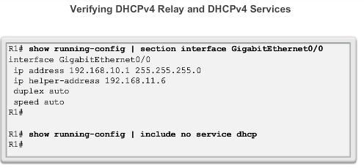
Troubleshoot DHCPv4 Verify Router DHCPv4 Configuration
Notes:
10.1 Managing IOS System Files
10.1.4 Troubleshoot DHCPv4
10.1.4.2 Verify Router DHCPv4 Configuration

Slide 18
Troubleshooting Task 1: Resolve IPv4 Address Conflicts
An IPv4 address lease can expire on a client still connected to a network. If the client does not renew the lease, the DHCPv4 server can reassign that IPv4 address to another client.The situation then arises where two clients are using the same IPv4 address, creating a conflict.
The show ip dhcp conflict command displays all address conflicts recorded by the DHCPv4 server. This output displays IP addresses that have conflicts with the DHCP server.
The server uses the ping command to detect clients. The client uses Address Resolution Protocol (ARP) to detect conflicts.
If an address conflict is detected, the address is removed from the pool and not assigned until an administrator resolves the conflict.
.

Slide 19
Troubleshooting Task 2: Verify Physical Connectivity
First, use the show interface interface command to confirm that the router interface acting as the default gateway for the client is operational.
If the state of the interface is anything other than up, the port does not pass traffic, including DHCP client requests.
Troubleshooting Task 3: Test Connectivity using a Static IP Address
When troubleshooting any DHCPv4 issue, verify network connectivity by configuring a static IPv4 address information on a client workstation. If the workstation is unable to reach network resources with a statically configured IPv4 address, the root cause of the problem is not DHCPv4. At this point, network connectivity troubleshooting is required.

Slide 20
Troubleshooting Task 4: Verify Switch Port Configuration
If the DHCPv4 client is unable to obtain an IPv4 address from the DHCPv4 server on startup, attempt to obtain an IPv4 address from the DHCPv4 server by manually forcing the client to send a DHCPv4 request. (ipconfig /renew)
If there is a switch between the client and the DHCPv4 server, and the client is unable to obtain the DHCP configuration, switch port configuration issues may be the cause. These causes may include issues from trunking, STP. PortFast configuration and edge port configurations resolve the most common DHCPv4 client issues that occur with an initial installation of a Cisco switch.

Slide 21
Troubleshooting Task 5: Test DHCPv4 Operation on the Same Subnet or VLAN
It is important to distinguish whether DHCPv4 is functioning correctly when the client is on the same subnet or VLAN as the DHCPv4 server. If DHCPv4 is working correctly when the client is on the same subnet or VLAN, the problem may be the DHCP relay agent.
If the problem persists even with testing DHCPv4 on the same subnet or VLAN as the DHCPv4 server, the problem may actually be with the DHCPv4 server.

Slide 22
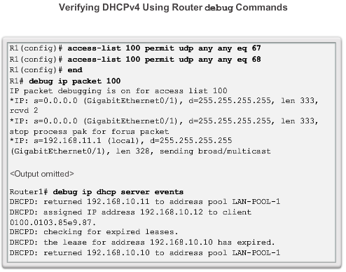
Troubleshoot DHCPv4 Debugging DHCPv4
On routers configured as DHCPv4 servers, the DHCPv4 process fails if the router is not receiving requests from the client.
As a troubleshooting task, verify that the router is receiving the DHCPv4 request from the client.
This troubleshooting step involves configuring an ACL for debugging output.
Notes:
10.1.4 Troubleshoot DHCPv4
10.1.4.3 Debugging DHCPv4

Slide 23
NAT Characteristics IPv4 Private Address Space
The IPv4 address space is not big enough to uniquely address all the devices that need to be connected to the Internet
Network private addresses are described in RFC 1918 and are to designed to be used within an organization or site only. Private addresses are not routed by Internet routers while public addresses are
Private addresses can alleviate IPv4 scarcity but since they aren’t routed by Internet devices, they need to be translated first.
NAT is process used to perform such translation
Notes:
11.1 NAT Operation
11.1.1 NAT Characteristics
11.1.1.1 IPv4 Private Address Space

Slide 24
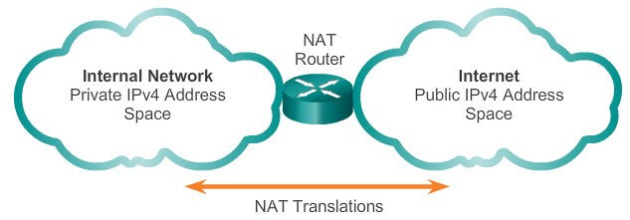
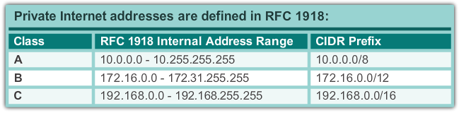
NAT Characteristics IPv4 Private Address Space
Notes:
11.1 NAT Operation
11.1.1 NAT Characteristics
11.1.1.1 IPv4 Private Address Space

Slide 25
NAT Characteristics What is NAT?
NAT is a process used to translate network addresses
NAT’s primary use is to conserve public IPv4 addresses
Usually implemented at border network devices such as firewalls or routers
This allows the networks to use private addresses internally, only translating to public addresses when needed
Devices within the organization can be assigned private addresses and operate with locally unique addresses.
When traffic must be sent/received to/from other organizations or the Internet, the border router translates the addresses to a public and globally unique address
Notes:
11.1 NAT Operation
11.1.1 NAT Characteristics
11.1.1.2 What is NAT?

Slide 26
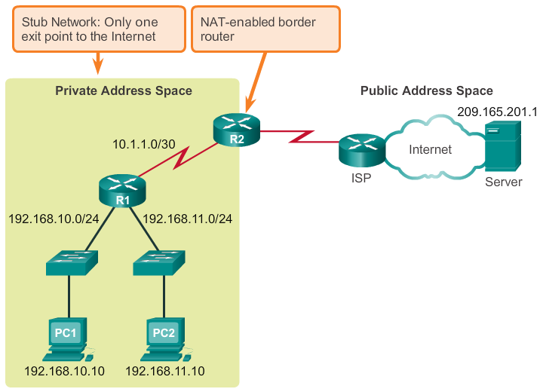
NAT Characteristics What is NAT?
Notes:
11.1 NAT Operation
11.1.1 NAT Characteristics
11.1.1.2 What is NAT?

Slide 27
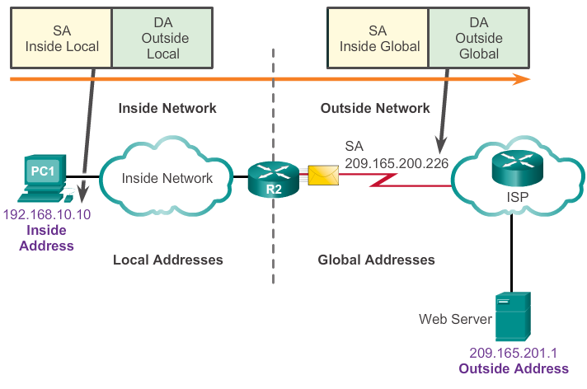
NAT Characteristics NAT Terminology
In NAT terminology, inside network is the set of devices using private addresses. Outside networks are all other networks
NAT includes 4 types of addresses:
Inside local address
Inside global address
Outside local address
Outside global address
Notes:
11.1 NAT Operation
11.1.1 NAT Characteristics
11.1.1.3 NAT Terminology

Slide 28
NAT Characteristics NAT Terminology
Inside local address - The address of the source as seen from inside the network i.e. 192.168.10.10 is assigned to PC1. This is the inside local address of PC1.
Inside global address - The address of source as seen from the outside network. In the figure, when traffic from PC1 is sent to the web server at 209.165.201.1, R2 translates the inside local address to an inside global address. In this case, R2 changes the IPv4 source address from 192.168.10.10 to 209.165.200.226. In NAT terminology, the inside local address of 192.168.10.10 is translated to the inside global address of 209.165.200.226.
Outside global address - The address of the destination as seen from the outside network. It is a globally routable IPv4 address assigned to a host on the Internet. For example, the web server is reachable at IPv4 address 209.165.201.1. Most often the outside local and outside global addresses are the same.
Outside local address - The address of the destination as seen from the inside network. In this example, PC1 sends traffic to the web server at the IPv4 address 209.165.201.1. While uncommon, this address could be different than the globally routable address of the destination.
Notes:
11.1 NAT Operation
11.1.1 NAT Characteristics
11.1.1.3 NAT Terminology

Slide 29
Types Of NAT
There are three types of NAT translation:
Static address translation (static NAT) - One-to-one address mapping between local and global addresses.
Dynamic address translation (dynamic NAT) - Many-to-many address mapping between local and global addresses.
Port Address Translation (PAT) - Many-to-one address mapping between local and global addresses. This method is also known as overloading (NAT overloading).

Slide 30
Types Of NAT Static NAT
Static NAT uses a one-to-one mapping of local and global addresses
These mappings are configured by the network administrator and remain constant
Static NAT is particularly useful when servers hosted in the inside network must be accessible from the outside network. Particularly useful for web servers or devices that must have a consistent address that is accessible from the Internet
A network administrator can access a server in the inside network by point his client to the proper inside global address.
Static NAT requires that enough public addresses are available to satisfy the total number of simultaneous user sessions.
Notes:
11.1 NAT Operation
11.1.2 Types Of NAT
11.1.2.1 Static NAT

Slide 31
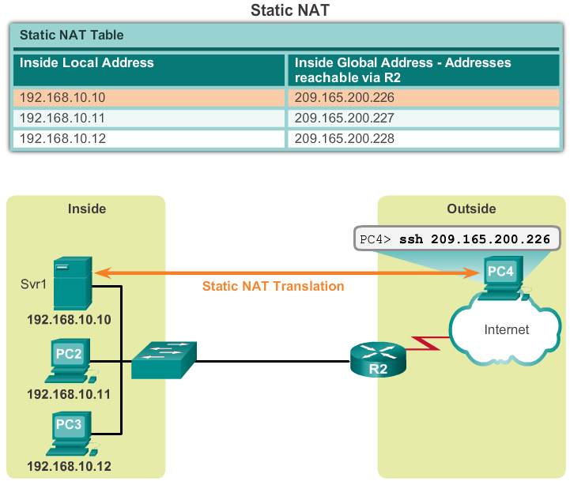
Types Of NAT Static NAT
Notes:
11.1 NAT Operation
11.1.2 Types Of NAT
11.1.2.1 Static NAT

Slide 32
Types Of NAT Dynamic NAT
Dynamic NAT uses a pool of public addresses and assigns them on a first-come, first-served basis
When an inside device requests access to an outside network, dynamic NAT assigns an available public IPv4 address from the pool
Dynamic NAT requires that enough public addresses are available to satisfy the total number of simultaneous user sessions
Notes:
11.1 NAT Operation
11.1.2 Types Of NAT
11.1.2.2 Dynamic NAT

Slide 33
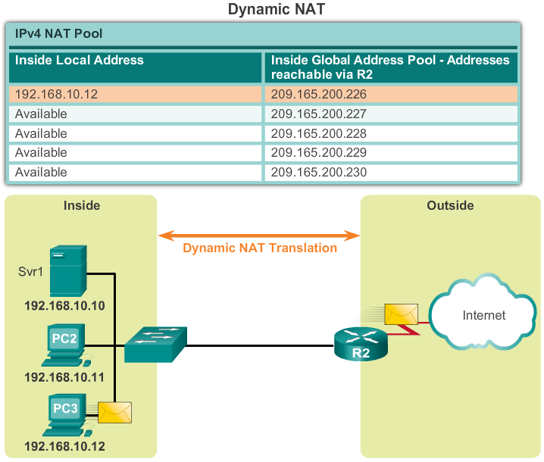
Types Of NAT Dynamic NAT
Notes:
11.1 NAT Operation
11.1.2 Types Of NAT
11.1.2.2 Dynamic NAT

Slide 34
Types Of NAT Port Address Translation NAT (PAT)
PAT maps multiple private IPv4 addresses to a single public IPv4 address or a few addresses
PAT uses the pair source port and source IP address to keep track of what traffic belongs to what internal client
PAT is also known as NAT overload
By also using the port number, PAT is able to forward the response packets to the correct internal device
The PAT process also validates that the incoming packets were requested, thus adding a degree of security to the session
Notes:
11.1 NAT Operation
11.1.2 Types Of NAT
11.1.2.3 Port Address Translation NAT (PAT)

Slide 35
Types Of NAT Comparing (Dynamic) NAT and PAT
(Dynamic) NAT translates IPv4 addresses on a 1:1 basis between private IPv4 addresses and public IPv4 addresses
PAT modifies both the address and the port number
(Dynamic) NAT forwards incoming packets to their inside destination by referring to the incoming source IPv4 address given by the host on the public network
With PAT, there is generally only one or a very few publicly exposed IPv4 addresses
PAT is also able to translate protocols that don’t use port numbers such as ICMP. Each one of these protocols are supported differently by PAT
Notes:
11.1 NAT Operation
11.1.2 Types Of NAT
11.1.2.5 Comparing NAT and PAT

Slide 36
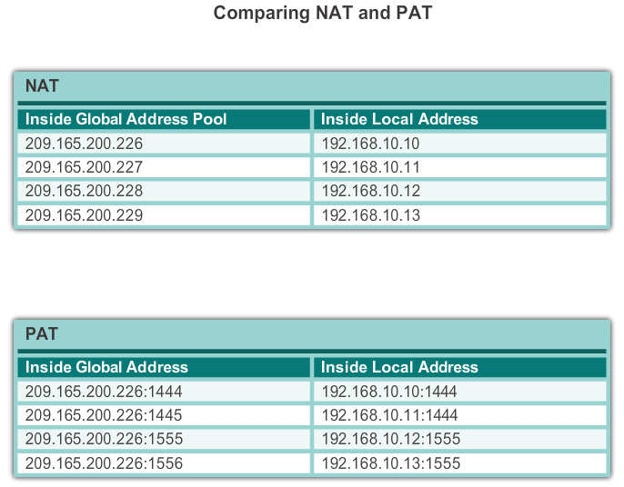
Types Of NAT Comparing (Dynamic) NAT and PAT
NAT translates IPv4 addresses on a 1:1 basis between private IPv4 addresses and public IPv4 addresses. However, PAT modifies both the address and the port number.
4 Public
Addresses
1 Public
Addresses

Slide 37
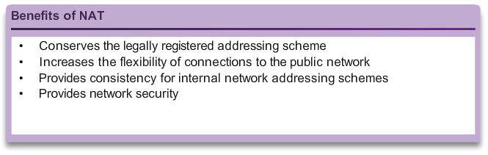
Benefits Of NAT Benefits of NAT
Notes:
11.1 NAT Operation
11.1.3 Benefits Of NAT
11.1.3.1 Benefits Of NAT

Slide 38
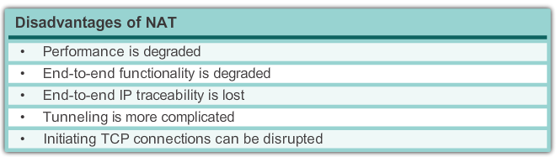
Benefits Of NAT Disadvantages of NAT
Notes:
11.1 NAT Operation
11.1.3 Benefits Of NAT
11.1.3.2 Disadvantages of NAT

Slide 39
Configuring Static NAT Configuring Static NAT
There are two basic tasks when configuring static NAT translations:
Create the mapping between the inside local and outside local addresses
Define which interface belong to the inside network and which belong to the outside network
Notes:
11.1 NAT Operation
11.2.1 Configuring Static NAT
11.2.1.1 Configuring Static NAT

Slide 40
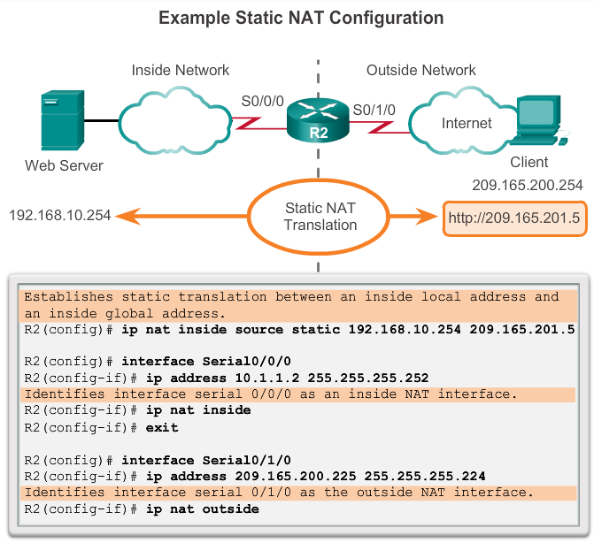
Configuring Static NAT Configuring Static NAT
Shows the commands needed on R2 to create a static NAT mapping to the web server in the example topology.
With the configuration shown, R2 translates packets from the web server with address 192.168.10.254 to public IPv4 address 209.165.201.5.
The Internet client directs web requests to the public IPv4 address 209.165.201.5. R2 forwards that traffic to the web server at 192.168.10.254.
Notes:
11.1 NAT Operation
11.2.1 Configuring Static NAT
11.2.1.1 Configuring Static NAT

Slide 41
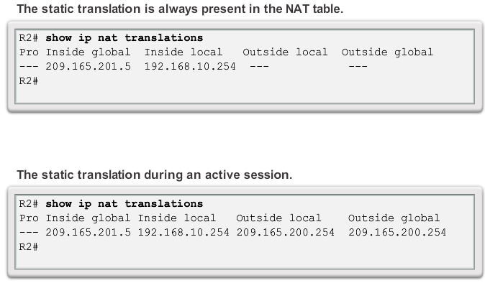
Configuring Static NAT Verifying Static NAT
Notes:
11.1 NAT Operation
11.2.1 Configuring Static NAT
11.2.1.2 Verifying Static NAT

Slide 42
Configuring Dynamic NAT Dynamic NAT Operation
The pool of public IPv4 addresses (inside global address pool) is available to any device on the inside network on a first-come first-served basis
With dynamic NAT, a single inside address is translated to a single outside address
The pool must be large enough to accommodate all inside devices
A device won’t be able to communicate to any external networks if no addresses are available in the pool
Notes:
11.1 NAT Operation
11.2.2 Configuring Dynamic NAT
11.2.2.1 Dynamic NAT Operation

Slide 43
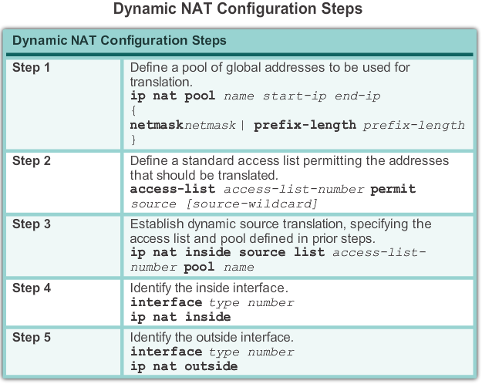
Configuring Dynamic NAT Configuring Dynamic NAT
Notes:
11.1 NAT Operation
11.2.2 Configuring Dynamic NAT
11.2.2.2 Configuring Dynamic NAT

Slide 44
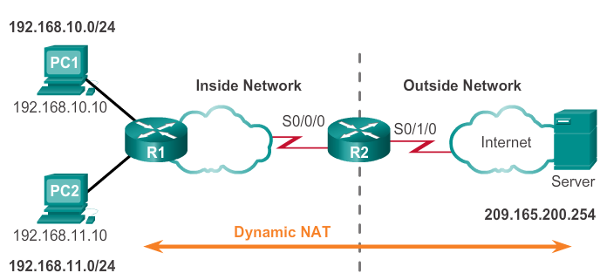
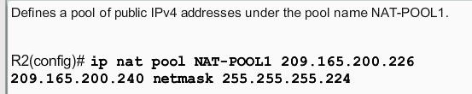
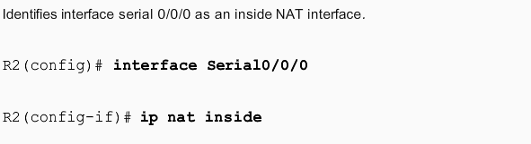
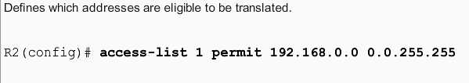
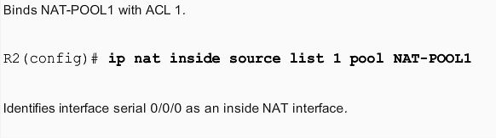
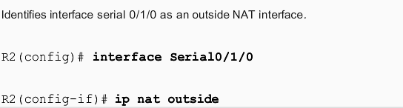
Configuring Dynamic NAT

Slide 45
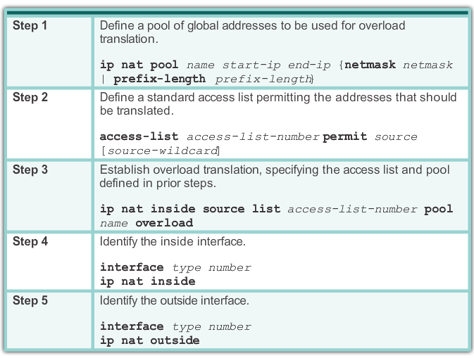
Configuring Port Address Translation (PAT) Configuring PAT: Pool of Addresses
PAT (also called NAT overload) conserves addresses in the inside global address pool by allowing the router to use one inside global address for many inside local addresses. In other words, a single public IPv4 address can be used for hundreds, even thousands of internal private IPv4 addresses
Notes:
11.1 NAT Operation
11.2.3 Configuring Port Address Translation (PAT)
11.2.3.2 Configuring PAT: Single Address

Slide 46
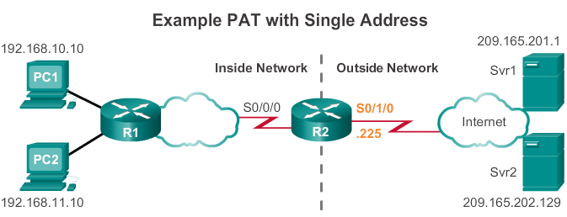
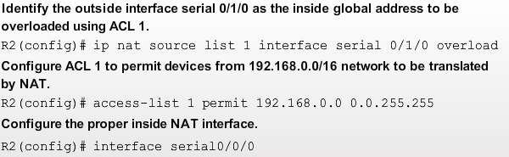
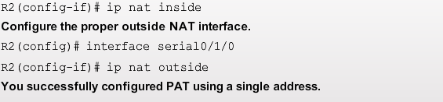
Configuring PAT for a Single Public IP Address

Slide 47
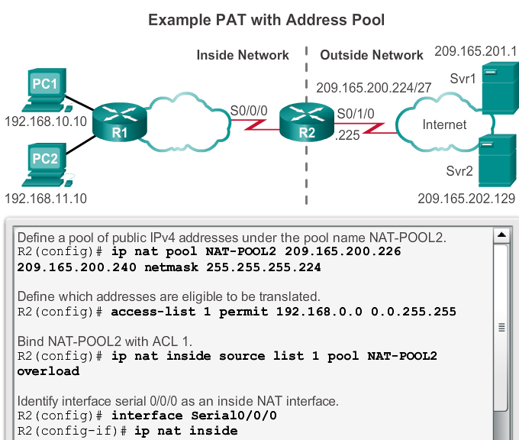

Configuring PAT for a Pool of Public IP Addresses
NAT-POOL2 contains addresses 209.165.200.226 to 209.165.200.240

Slide 48
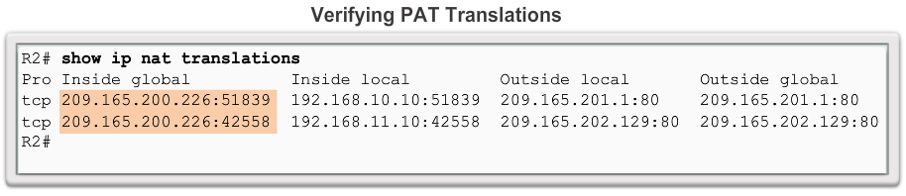
Configuring Port Address Translation (PAT) Verifying PAT
Notes:
11.1 NAT Operation
11.2.3 Configuring Port Address Translation (PAT)
11.2.3.4 Verifying PAT

